Slide 1
Inferential properties

Slide 2
Inferential properties
accurate property measurement is key
property measurement
mathematical techniques (to infer a property) - "soft sensors" or "virtual analysers"
on-stream analysers
Notes:
Accurate property measurement is key to harvest most of the many benefits of process control. Money can be made by more closely approaching product quality specifications. Process conditions can be continuously optimised provided good product quality control is in place.
Property measurement falls into two basic categories:
- Mathematical techniques where basic process measurement of flow, temperature and pressure are used to infer a property. Often also called soft sensors or virtual analysers they are used mainly to predict product quality but may be used for any parameter that cannot be measured directly - such as column flooding, catalyst activity, rate of coking etc.
- Use of on-stream analysers to directly measure product quality
Even if reliable on-stream analyser exists it is usually still worthwhile to develop an inferential. Since the inferential is based primarily on basic measurements it will respond much more quickly than the analyser.

Slide 3
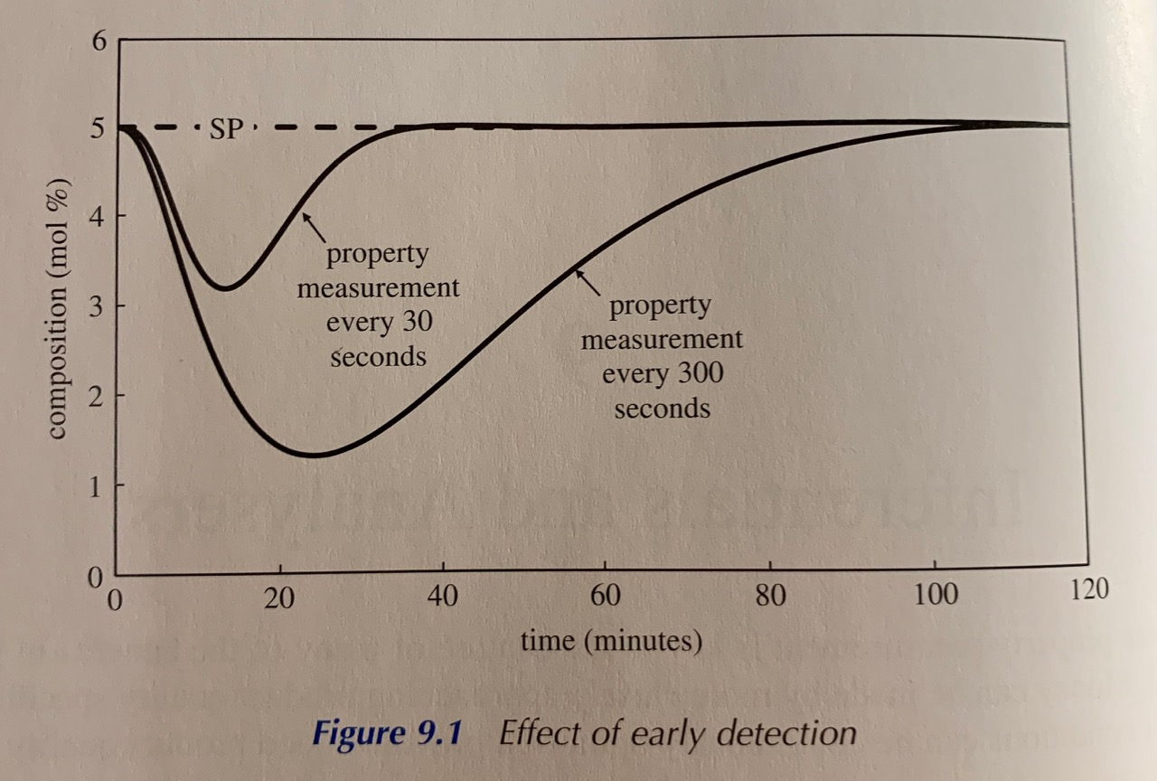
Inferential properties
Notes:
Example process on graph shows the benefit of this dynamic advantage. Both curves are from optimally tuned PID controller responding to the same process disturbance. Increasing the sample interval from 30 to 300 seconds resulted in a much larger deviation from desired value (setpoint - SP).

Slide 4
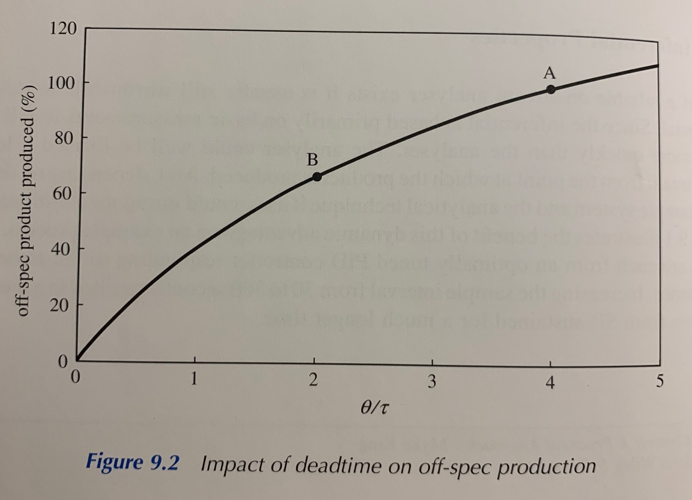
Inferential properties
Notes:
Graph shows the potential economic benefit. Point A represents a typical benchmark with deadtime / process lag ratio of 4. This might be a process lag of 5 minutes and deadtime of 20 minutes - both quite reasonable dynamics for process such as distillation column with a chromatograph on the distillate product rundown. In these circumstances the inferential could be expected to reduce the deadtime by at least 10 minutes (point B). Doing so would allow the controller to be tuned more quickly and would result in a reduction by about 33% in off-spec production.

